Slide 1
E-DOC APPOINTMENT SYSTEM
Shahad Parveen
4SO21MC041
4th Semester MCA
Internal Guide: Ms. Rakshitha P Assistant Professor | External Guide: Mr. H N Rohith Director of Business Operations

Slide 2
CONTENTS
COMPANY PROFILE
INTRODUCTION OF PROJECT
SOFTWARE REQUIREMENTS SPECIFICATION
ARCHITECTURAL DESIGN
DESIGN DOCUMENT
PSEUDO CODES
CONCLUSION
SCREENSHOTS
REFERENCES

Slide 3
COMPANY PROFILE
RineX is an exceptional E-learning platform catering to both students and professionals. It emphasizes the platform's commitment to offering high-quality technical certification courses taught by experienced industry experts, along with a wealth of study resources. They offer different types of courses such as Artificial Intelligence, AutoCAD, Catia, Data Science, VLSI, Machine learning, IoT and robotics, AWS, web development, etc. They provide government-approved certificates. They also provide projects along with courses.
13-09-2023
Department of Computer Applications
SJEC, Mangaluru

Slide 4
INTRODUCTION OF PROJECT
The E-Doc appointment system aims to replace the current manual process with an automated solution utilizing computerized hardware and comprehensive software, ensuring efficient data storage and accessibility. By streamlining the scheduling process and eliminating errors, this system will provide quick, secure, and reliable management. This system has three main users, the Admin, Doctor, and Patient. This system streamlines appointment scheduling for patients and doctors, offering online convenience. Patients can register, select their preferred doctor, and book appointments on their chosen day and time, enhancing accessibility and ease of use. The automated approach will enhance resource management and eliminate redundant data entry, allowing the focus to remain on critical information retrieval.
13-09-2023
Department of Computer Applications
SJEC, Mangaluru

Slide 5
SOFTWARE REQUIREMENTS SPECIFICATION
System Description: The E-DOC appointment system is a web-based application that allows users to create, manage, and access electronic documents related to appointments.
User Roles:
Administrator: Responsible for system configuration, user management, and overseeing overall system operation.
Patients: The majority of system users are patients. They can register, view doctor profiles, determine the doctors' availabilities, and make appointments.
Doctors: The system is used by doctors to manage their schedules, view appointments, and adjust their availability.
13-09-2023
Department of Computer Applications
SJEC, Mangaluru

Slide 6
SOFTWARE REQUIREMENTS SPECIFICATION
Functional Requirements:
User registration and authentication: Patients, doctors, and administrators can set up accounts and use the proper credentials to log in safely.
Doctor profiles: Admins have the ability to establish and manage doctor profiles, which can include contact information, personal details, specialty, and credentials.
Appointment Scheduling: Patients can examine the schedules of the doctors who are available and make appointments based on those schedules.
13-09-2023
Department of Computer Applications
SJEC, Mangaluru

Slide 7
SOFTWARE REQUIREMENTS SPECIFICATION
Functional Requirements:
Appointment Management: Doctors may manage their availability and monitor their planned appointments. They can also accept or reject requests for appointments.
Rescheduling and Cancelling Appointments: Both patients and doctors have the right to cancel appointments.
Administrative Dashboard: To manage user accounts, address technical difficulties, and keep an eye on how the system is running overall, administrators have access to a feature-rich dashboard.
13-09-2023
Department of Computer Applications
SJEC, Mangaluru

Slide 8
SPECIFIC REQUIREMENTS
Hardware
Processor Speed : 2.4 GHZ or higher
RAM : 1GB or more
Hard Drive : 10GB or more
Software
Language : PHP, HTML
Frontend : Visual Studio Code
Database (Backend): MySQL Server
13-09-2023
Department of Computer Applications
SJEC, Mangaluru

Slide 9
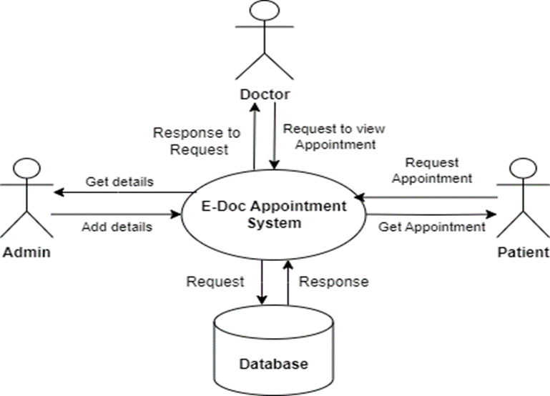
ARCHITECTURAL DESIGN
9
13-09-2023
Department of Computer Applications
SJEC, Mangaluru

Slide 10
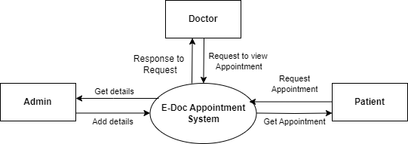
DESIGN DOCUMENT
10
CONTEXT FLOW DIAGRAM
13-09-2023
Department of Computer Applications
SJEC, Mangaluru

Slide 11
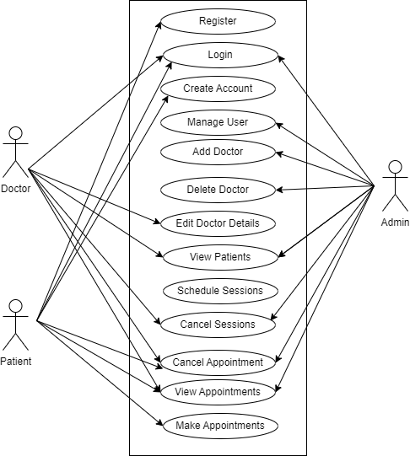
DESIGN DOCUMENT
11
Actors:
Admin, Patient, and Doctor.
Use Cases:
Manage user, Add doctors, Delete doctors, Edit doctor details, View patients, Schedule sessions, Cancel Sessions, Make appointments, Cancel appointments, View appointments.
USE CASE DIAGRAM
13-09-2023
Department of Computer Applications
SJEC, Mangaluru

Slide 12
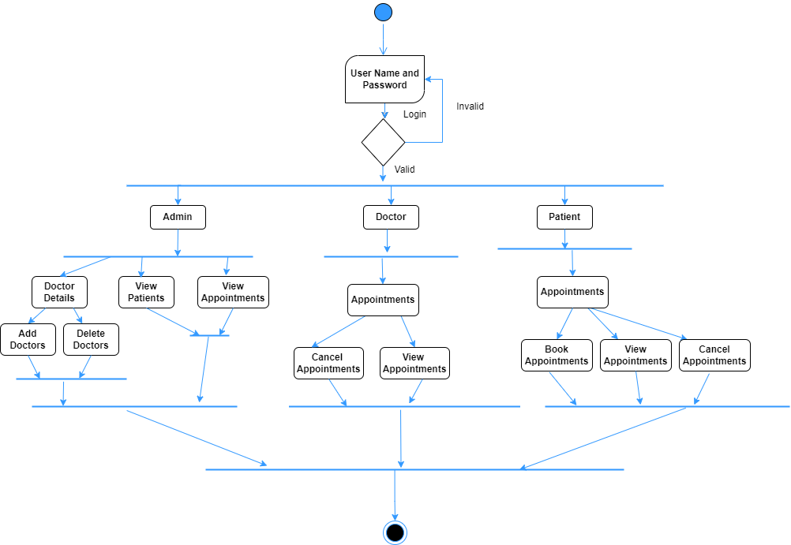
DESIGN DOCUMENT
12
ACTIVITY DIAGRAM
13-09-2023
Department of Computer Applications
SJEC, Mangaluru

Slide 13
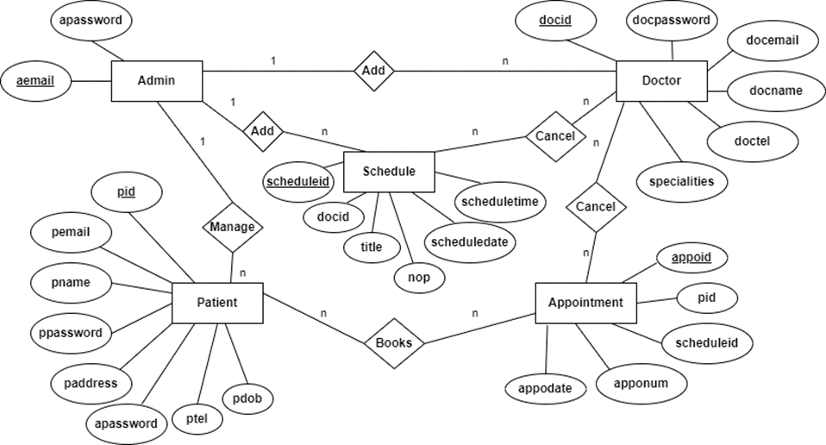
DESIGN DOCUMENT
13
ER DIAGRAM
13-09-2023
Department of Computer Applications
SJEC, Mangaluru

Slide 14
PSEUDO CODES
Pseudo Code For The Registration Page
Users must register to the system. While registering users need to input their name, email ID, address, date of birth, contact number, and password. If the data is valid then the user will login to the user page.
BEGIN
Input Name, Email-id, Address, Date of Birth, Contact Number, Password, Confirm Password Check whether data is valid and mandatory fields are filled.
If data valid, then
Update to database
Else
Show error
End if
13-09-2023
SJEC, Mangaluru

Slide 15
PSEUDO CODES
Pseudo Code For Login Page
BEGIN
Input Email and password. Check whether data is valid and mandatory fields are filled.
If Email and Password exists, then
checkUserType ()
If user equals admin
showAdminHome()
Else if user equals doctor
showDoctorHome()
Else
showUserHome()
End If
Else
Show error
End if
The user needs to log in with the Email Address and password, if the Email Address exists then we need to see whether the password matches, if the password matches then there will be successful login, or else an error message will be displayed.
13-09-2023
SJEC, Mangaluru

Slide 16




CONCLUSION
In conclusion, the E-doc Appointment System offers a straightforward and effective approach to managing appointments across various sectors. Its real-time updates, automated scheduling, and user-friendly interface enhance user and administrative experiences, resulting in improved productivity. By minimizing manual tasks, resolving scheduling conflicts, and optimizing resource allocation. Successfully implemented and tested on Windows 10 and above, the e-doc system's integration of technology into traditional appointment processes demonstrates its positive impact. With its role in managing doctor details, sessions, and appointments, it not only reduces paperwork but also ensures secure data storage, promising a more organized and efficient future.
13-09-2023
SJEC, Mangaluru

Slide 17

Screenshots
17
13-09-2023
Department of Computer Applications
SJEC, Mangaluru

Slide 18
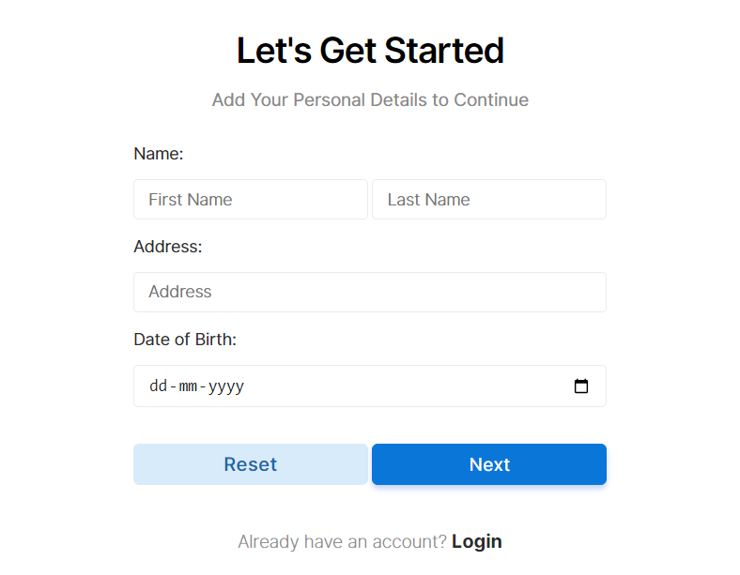
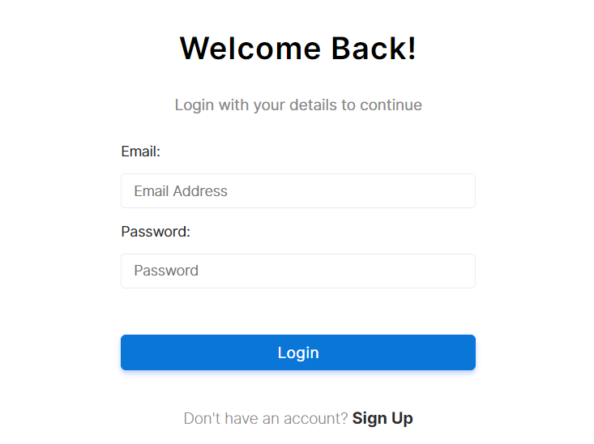
Screenshots
18
13-09-2023
Department of Computer Applications
SJEC, Mangaluru

Slide 19
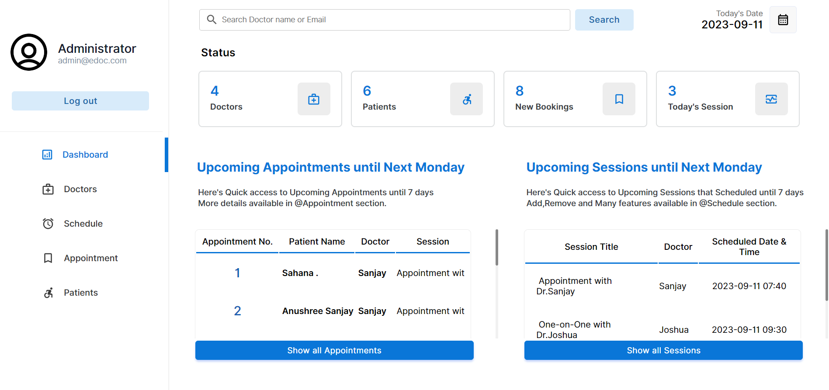
Screenshots
19
13-09-2023
Department of Computer Applications
SJEC, Mangaluru

Slide 20
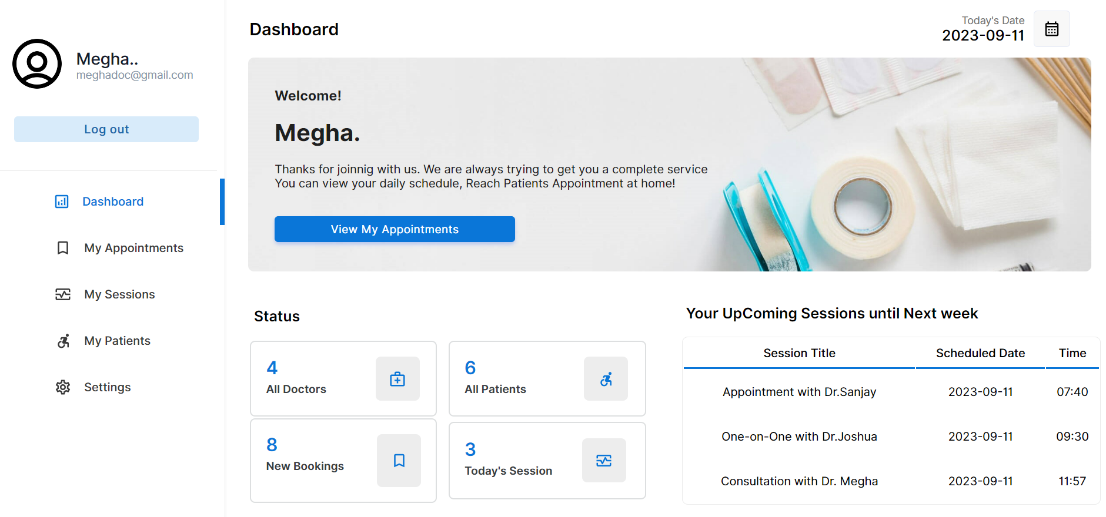
Screenshots
20
13-09-2023
Department of Computer Applications
SJEC, Mangaluru

Slide 21
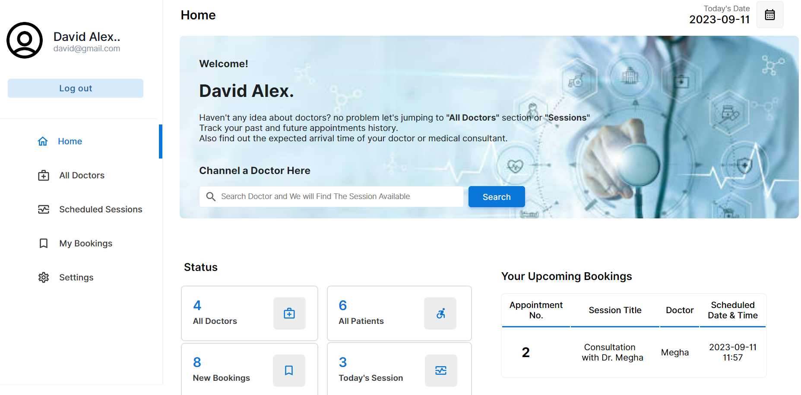
Screenshots
21
13-09-2023
Department of Computer Applications
SJEC, Mangaluru

Slide 22
REFERENCES
22
[1] Hassan, Md Arif, et al. "Enhanced Security of User Authentication on Doctor E-Appointment System." Innovative Data Communication Technologies and Application: Proceedings of ICIDCA 2021. Singapore: Springer Nature Singapore, 2022. 47-63.
[2] Jadhav, Prakash, et al. "Smart Pulmonary System with Doctor Appointment."
[3] Zhang, Min, et al. "The Impact of Narrative Reviews on Patient E-doctor Choice in Online Health Communities." INQUIRY: The Journal of Health Care Organization, Provision, and Financing 60 (2023): 00469580231183695.
[4] Rawabdeh, Ali Ahamd Awad. "An e‐health trend plan for the Jordanian health care system: a review." International journal of health care quality assurance 20.6 (2007): 516-531.
[5] Nixon (Robin), Learning PHP MySQL and JavaScript, Publication: Shroff publishers & Distributors Pvt Pankaj Jalote Ltd.
13-09-2023
Department of Computer Applications
SJEC, Mangaluru

Slide 23
THANK YOU

